Slide 1
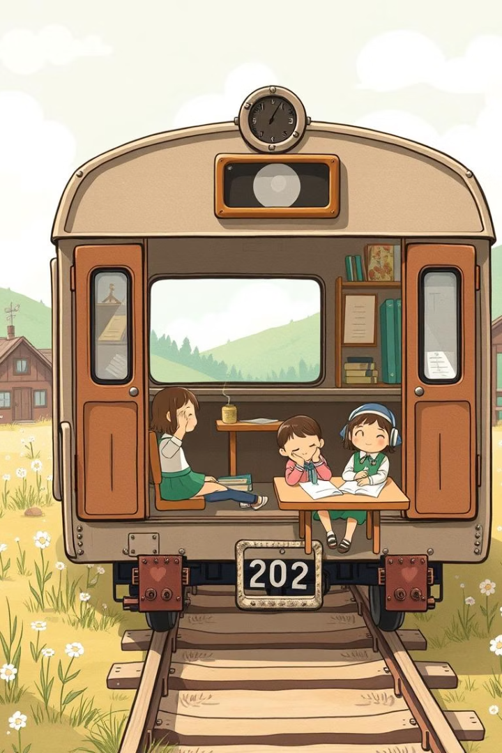



The Classroom in the Train: An Adventure in Learning
Welcome to Totto-chan's extraordinary school! Join us on a journey to Tomoe Gakuen and explore the unique educational philosophy of Tetsuko Kuroyanagi's beloved book.
by Praveena Ramesh

Slide 2
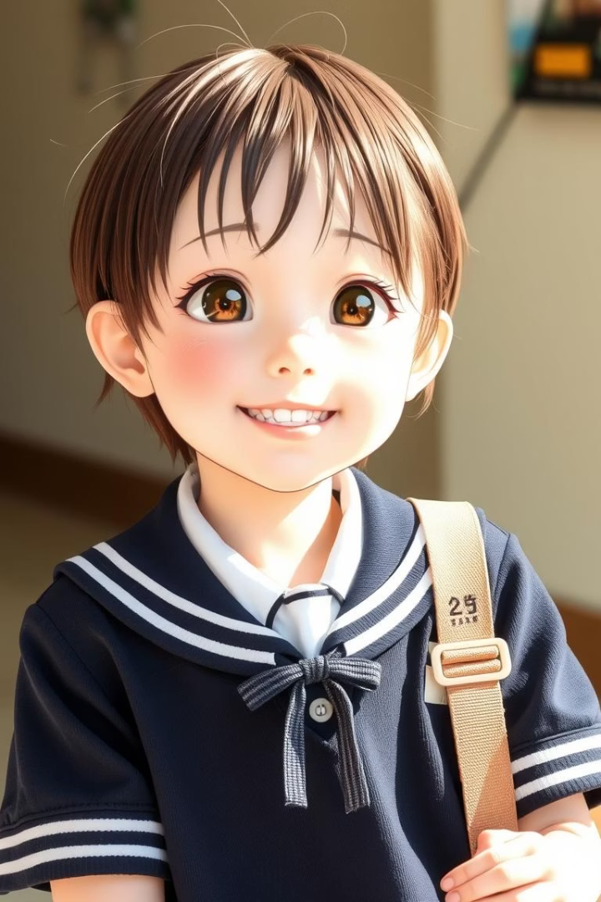
Who is Totto-chan?
A Curious Spirit
Why Expelled?
Totto-chan is an energetic and inquisitive young girl.
She was expelled for being too lively for her old school.
Her Uniqueness
Her individuality makes her truly special.

Slide 3
Tomoe Gakuen: A Different Kind of School
Unusual Classrooms
Unique Approach
Classrooms are set inside old train cars.
It prioritizes freedom, creativity, and individuality.
Each car offers a unique learning space.
Learning is flexible and student-centered.

Slide 4
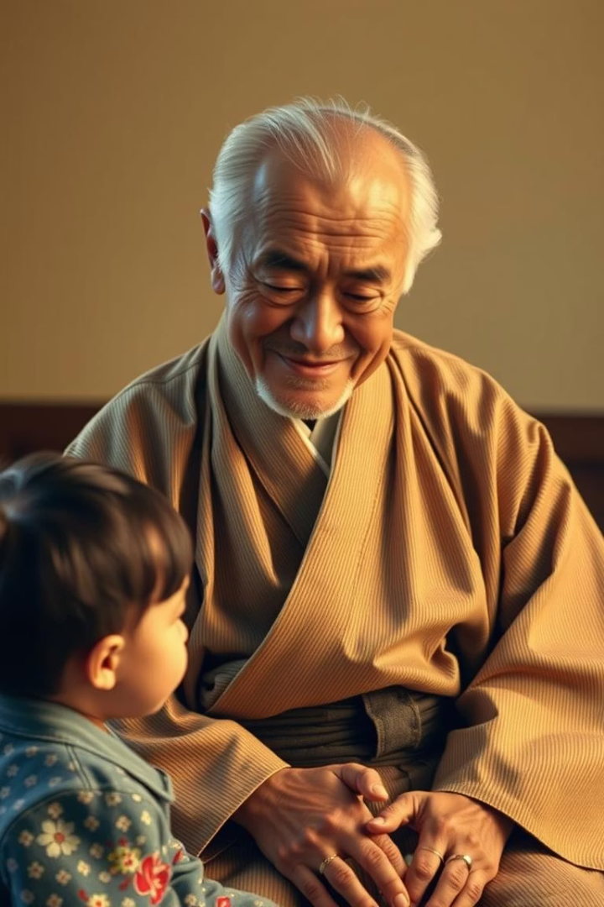



Mr. Kobayashi: An Understanding Headmaster
Active Listener
He listens intently to every child.
Unique Pedagogy
His methods encourage genuine curiosity.
Fosters Growth
He cultivates a love for learning.

Slide 5
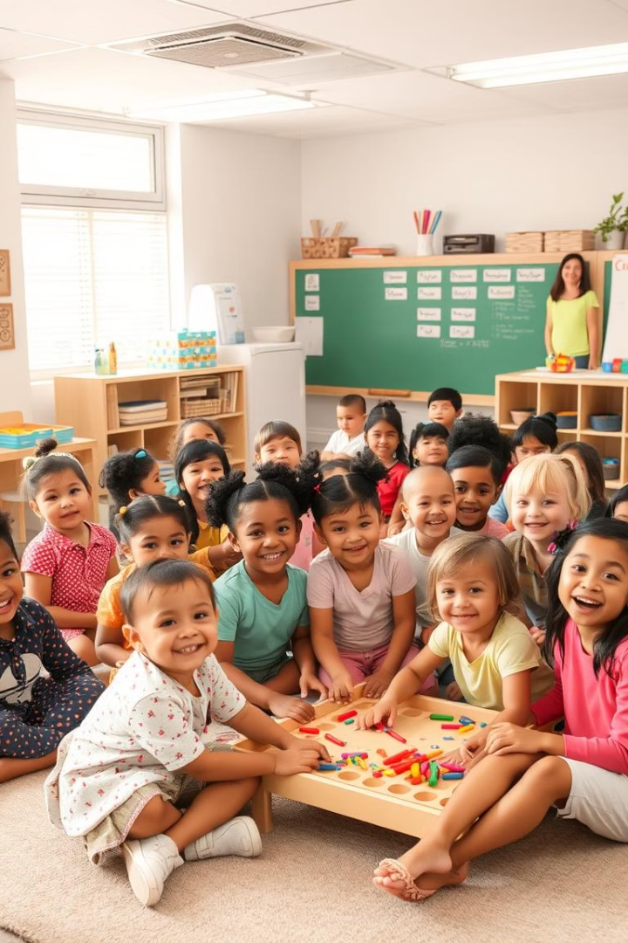
Key Themes: Acceptance and Individuality
Embracing Differences
Patience and Understanding
Tomoe Gakuen celebrates each student's unique qualities.
The school values patience and deep understanding.
Sense of Belonging
It fosters a strong sense of community and acceptance.

Slide 6




Key Themes: Unconventional Teaching Methods
Flexible Curriculum
Learning is personalized and adaptable.
Experiential Learning
Students learn through hands-on activities.
Encouraging Exploration
Curiosity and discovery are highly valued.

Slide 7



Discussion: What Can We Learn from
Tomoe Gakuen?
Benefits of Unconventional Methods
2
What advantages do these approaches offer?
Inclusive Classrooms
How can we create supportive environments?
1
Embracing Individuality
3
How do we celebrate unique qualities in ourselves and others?

Slide 8
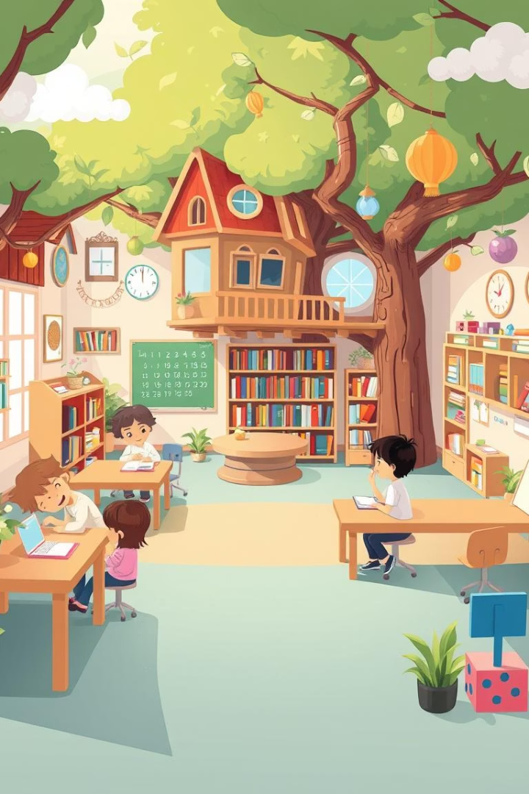
Reflection: Your Dream Classroom
Imagine Your Ideal Space
Visualize your perfect learning environment.
What Would You Learn?
Consider the subjects and skills that excite you.
Bring Tomoe's Spirit
How can you apply these ideas to your life?

